Slide 1
Programming Made Easy
Bartek Wasielak

Slide 2




About me
Bartek Wasielak
@bwasielak

Slide 3
Agenda
Programming in general
Different techs and languages
Programming for the Web
Introduction to OOP
Hands On Lab

Slide 4
Programming in general

Slide 5
What can we achieve?
Build application no-one’s built
Modify existing app’s behaviour
Consume any data
Make your life easier
Fun!
Notes:
An application for my wife for time tracking – there was no simple free time tracking app

Slide 6
Different kind of applications
Desktop applications
Web applications
Mobile applications
Embedded applications
Notes:
Desktop apps are usually specific for a particular platform (operating system). Sometimes they can be OS agnostic. Usually not so robust as native ones.
Explain what native means.
Web application – works on a server side, presented to a user by a browser. Usually OS and browser agnostic. Sometimes use technology that requires specific OS/browser. Example: Flash doesn’t work on iOS. Silverlight has no official and current implementation for Linux (works on Windows and Mac only)

Slide 7
Technologies and languages

Slide 8
What does a computer do?
Computer programs are text documents
Programs are executed by a processor (CPU)
CPU doesn’t execute text

Slide 9
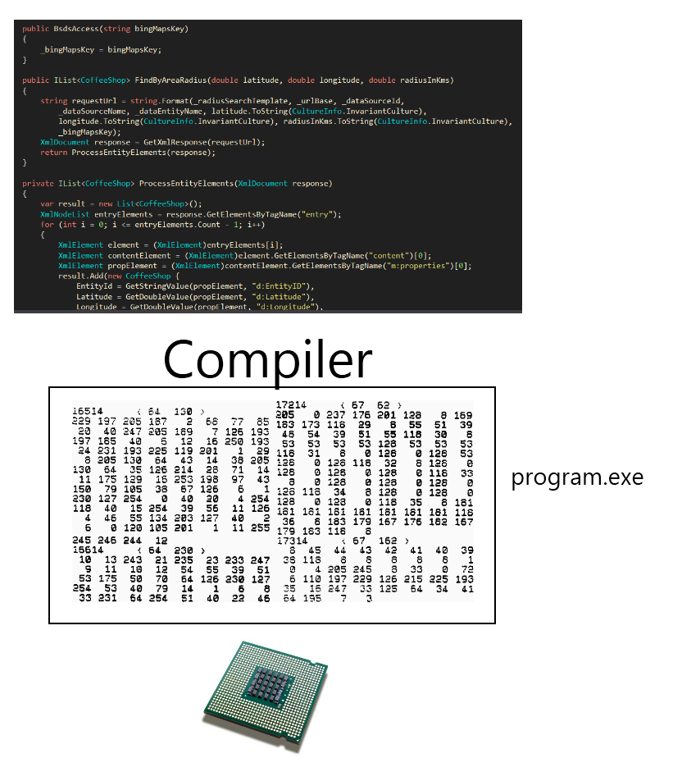
Compiling

Slide 10
Compiling
Maximum robustness
Need to compile against every CPU

Slide 11
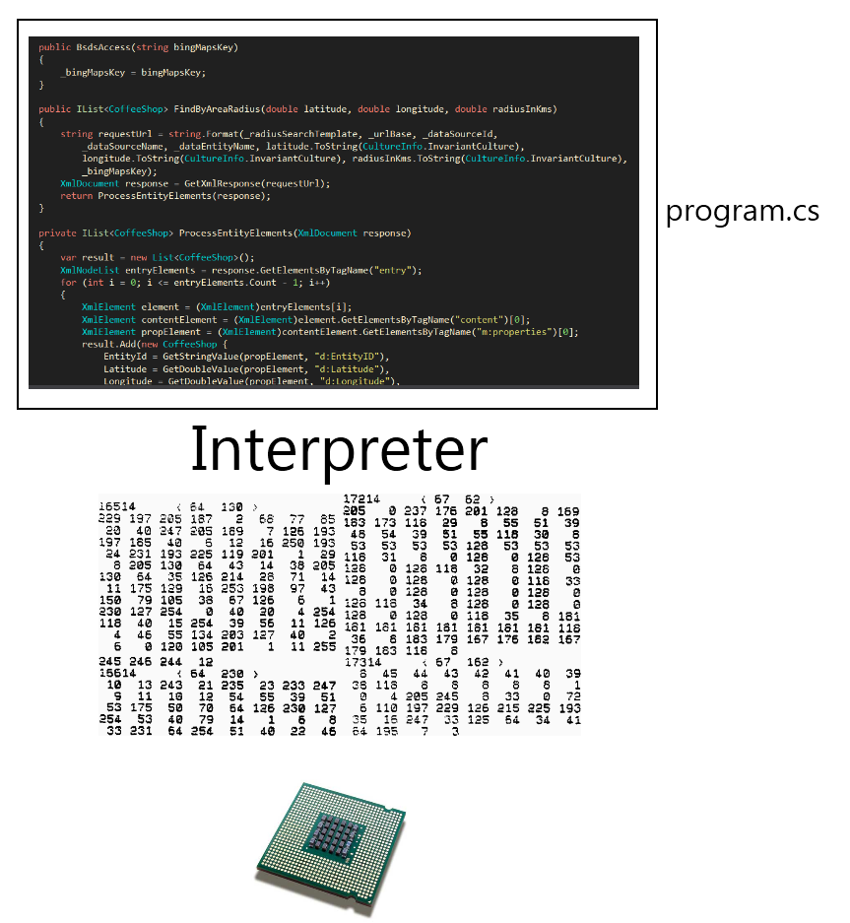
Interpretation

Slide 12
Interpretation
Poor efficiency
Need to have an interpreter for every OS/CPU
Everyone can see the code
No need to recompile
Notes:
Often used in the Web

Slide 13
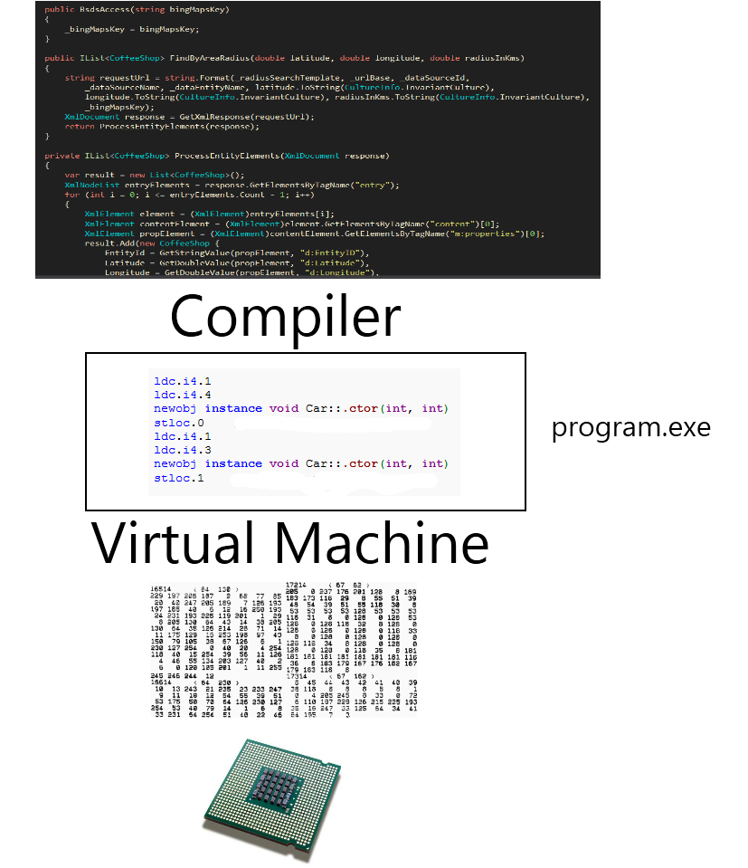
Virtual machine

Slide 14
Virtual machine
Medium efficiency
Compile once – to bytecode
Need to have a VM for every OS/CPU

Slide 15
The Web

Slide 16
Web request
User types an address in a browser
The browser contacts a right server
The server recognizes the request
The server finds a program bound to the address
The program executes and returns an HTML document
The browser downloads the document
The browser executes all the code attached to the documents

